Slide 1
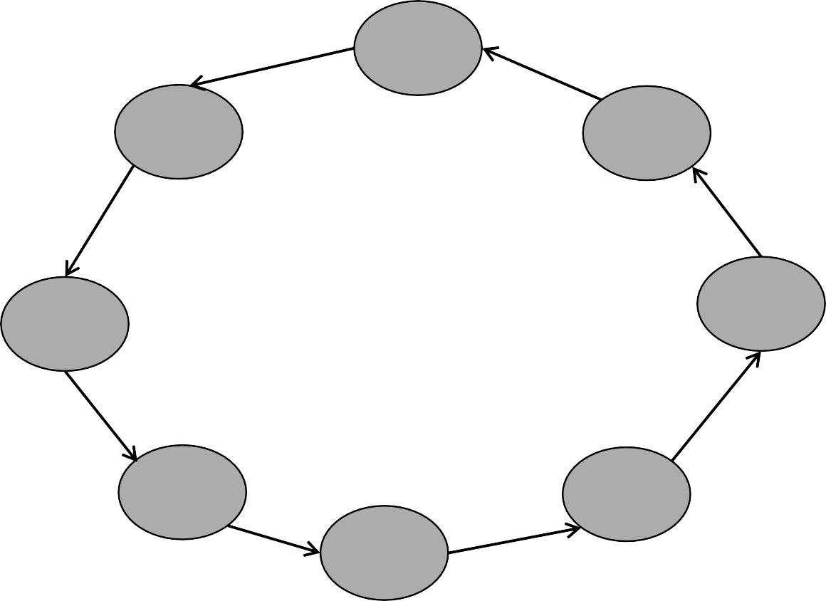
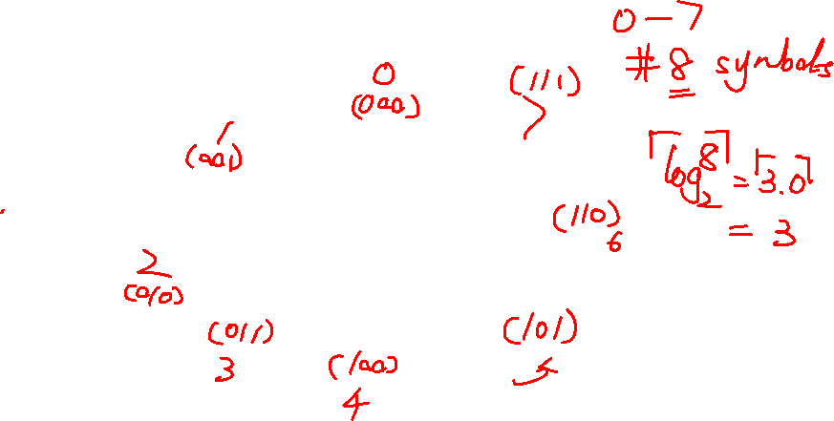
Design counter using T flip-flops
Design a three-bit counter consisting of three T flip-flops
that can count in binary form from 0 to 7
State diagram:

Slide 2

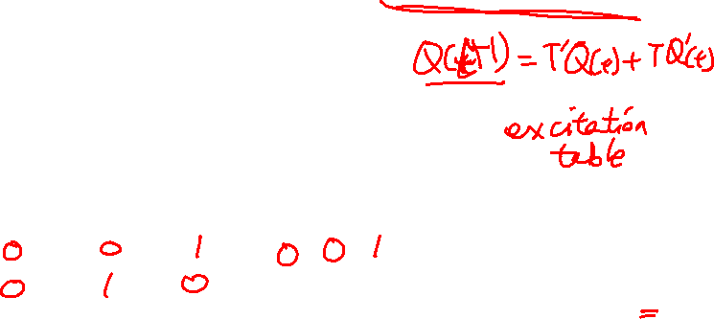
Design counter using T flip-flops
State Table
Present state |  |  | Next state |  |  | Flip-Flop Inputs
A | B | C |  |  |  | T_{A} | T_{B} | T_{C}
0 | 0 | 0
0 | 0 | 1
0 | 1 | 0
0 | 1 | 1
1 | 0 | 0
1 | 0 | 1
1 | 1 | 0
1 | 1 | 1
Q(t) | Q(t+1) | T
0 | 0 | 0
0 | 1 | 1
1 | 0 | 1
1 | 1 | 0
A⁺
B⁺
C⁺

Slide 3
Design counter using T flip-flops
T
AB
A
Present state |  |  | Next state |  |  | Flip-Flop Inputs
A | B | C |  |  |  | T_{A} | T_{B} | T_{C}
0 | 0 | 0
0 | 0 | 1
0 | 1 | 0
0 | 1 | 1
1 | 0 | 0
1 | 0 | 1
1 | 1 | 0
1 | 1 | 1
C
00 01 11 10
0
1
A⁺
B⁺
C⁺
T
AB
B
C
00 01 11 10
0
1
AB
C
00 01 11 10
T_{C}
0
1

Slide 4
Design counter using T flip-flops
TA=
TB=
TC=
Logic diagram

Slide 5
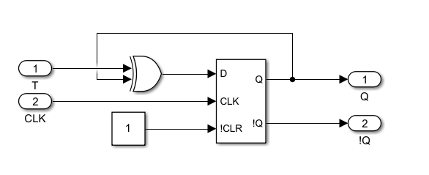
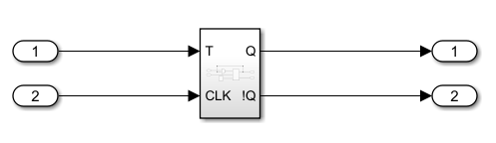

3. Implement the circuit in Simulink
1. Create the T flip flop. Use ‘D flip flop’, ‘in’, ‘out’ create the T flip flop and make it as a subsystem.
2. Use the subsystem create the 0-7 counter in a new workspace.
For clock signal, use and use the default period 2.
Use scope to observe the output Q of three flip flops. Time duration of the waveform is set as 40.

